Slide 1

Telerik B ackend Services
You'll find it empowering ..

Slide 2
So, you're building a modern app
Mobile / Web / Desktop

Slide 3
Problems you face ..
How do you manage & scale Data?
Is your data Platform-agnostic?
Relational Vs Non-Relational data storage?
Do you have consistent APIs on top of your data?
How do you handle Users & Authentication?
Do you need scalable code running in the cloud?
X-Platform Mobile Push Notifications a distant dream?
Legacy data holding you back?

Slide 4
Debilitating concerns .. we know
Backend plumbing - done right!

Slide 5








Why Telerik Backend Services?
Complete Backend-as-a-Service (BaaS) offering One portal to rule it all
Secure Data storage - relational or non-relational Consistent APIs & Cloud code
Social User authentication & Management Easy X-Platform Mobile Push Notifications Easy Data Connectors to On-premise data
X-Platform SDKs and extensive product Integrations

Slide 6
That's a lot of features ..
No worries - let's break it down

Slide 7
Where do I start?
Simply head to
https://platform.telerik.com/

Slide 8
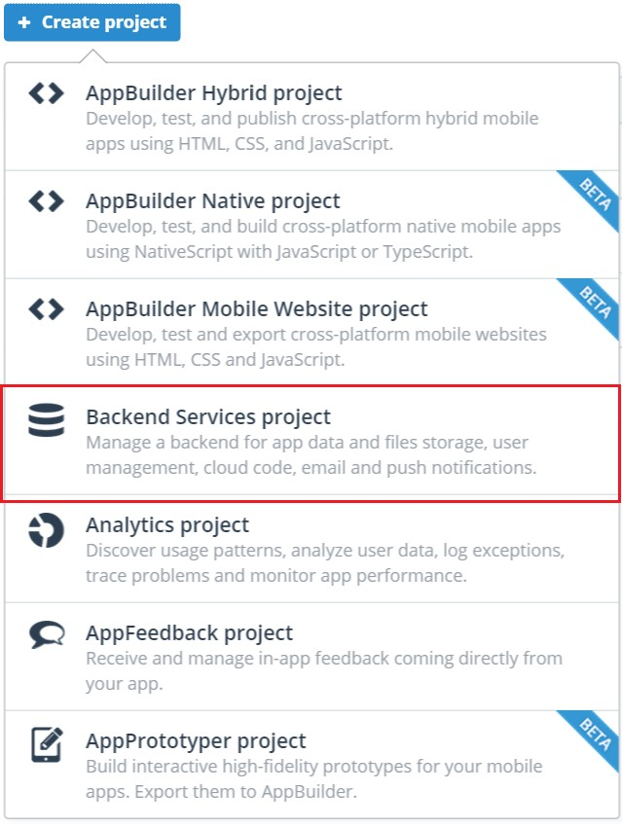
Sign in & Create an App ..
Then, start a Backend Services project

Slide 9
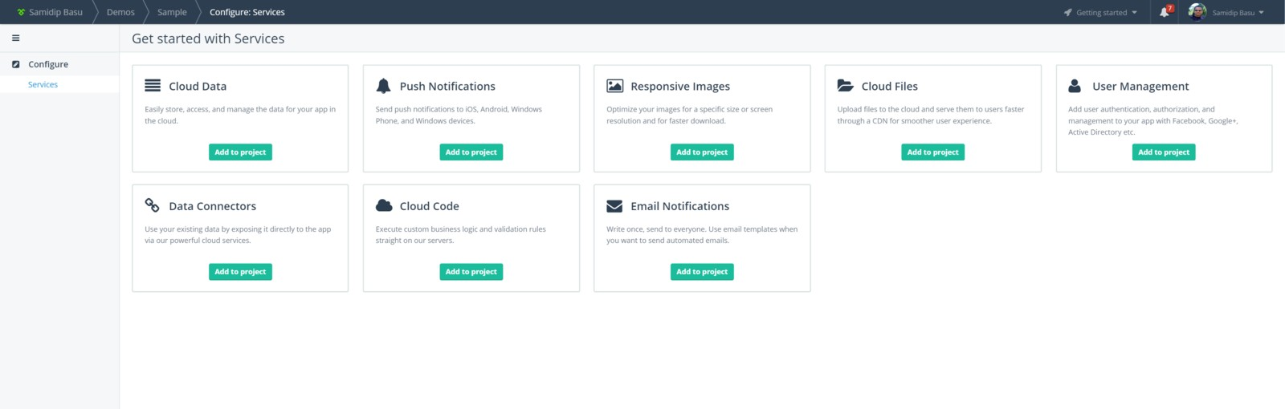
And just like that ..
Your Backend Services Dashboard is ready

Slide 10
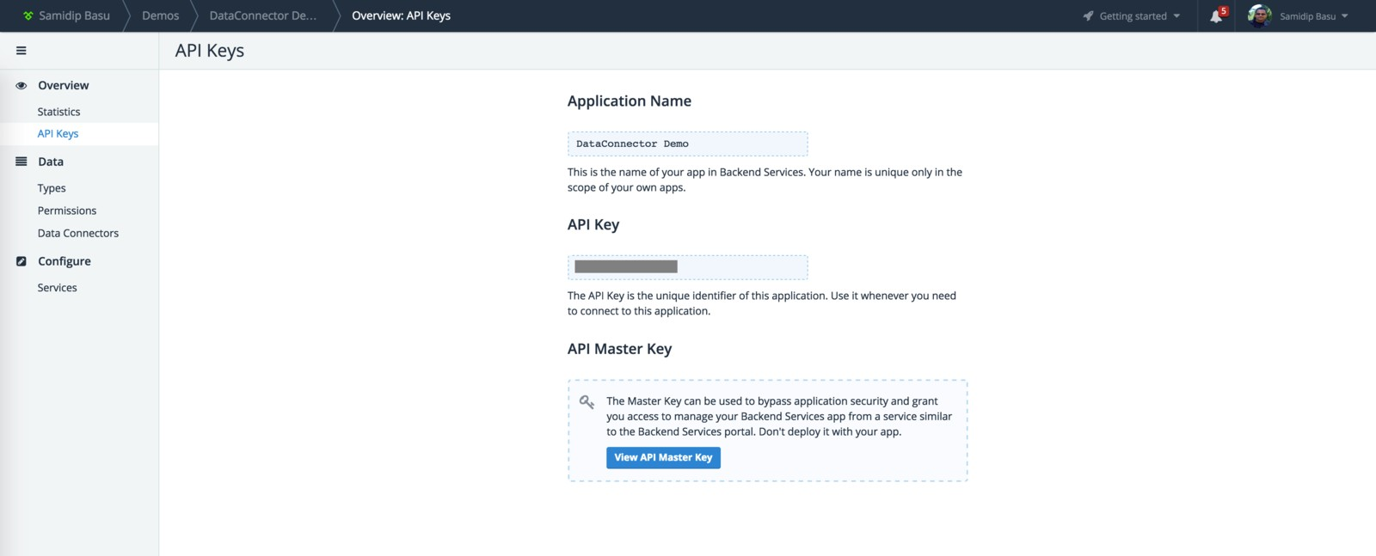
See that API Key?
It's important and unique to your Backend

Slide 11
#1. Let's talk SDKs
You get wrappers .. over a consistent REST API
JavaScript SDK
.NET SDK
iOS SDK
Android SDK
Cloud Code

Slide 12
That's pretty much everything ..
Yup, that's the goal
Native SDKs make it easy to work with Backend Services REST API
Makes for smooth Integrations
Any App, Any Platform

Slide 13
#2. Let's talk about Data
Can't be local in devices only
Users will want to roam between platforms/devices
Data types - Relational & Non-relational
Data needs exposed through clean APIs
Security & Scalability concerns

Slide 14
Telerik Backend Services
Complete, Fast & Robust Mobile Backend as a Service
Your data however you want it
Scalable BaaS in the cloud

Slide 15
Backend Content Types
Like a Table in a Relational Database Only in the cloud & accessible
Content has Fields that describe the Data Like column schema in a Table

Slide 16
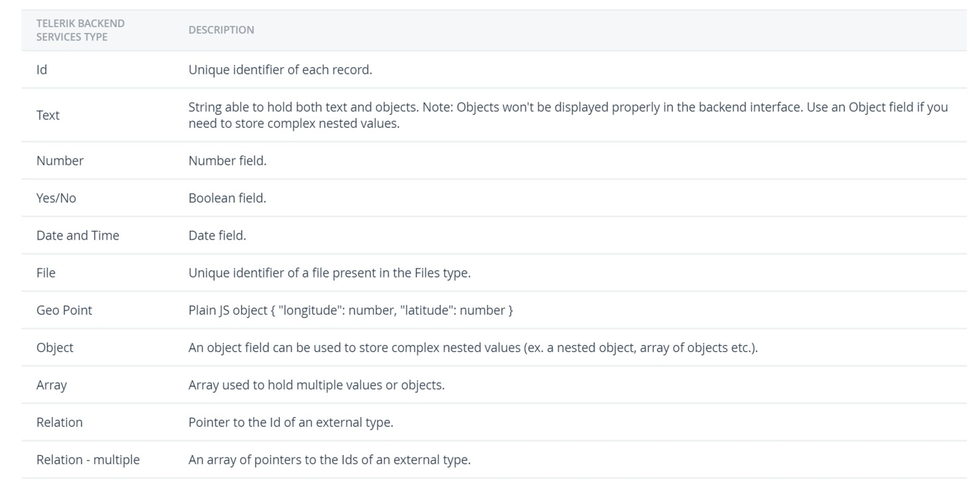
Backend Content Fields
Oh, and Content can be Related .. like Table relationships

Slide 17
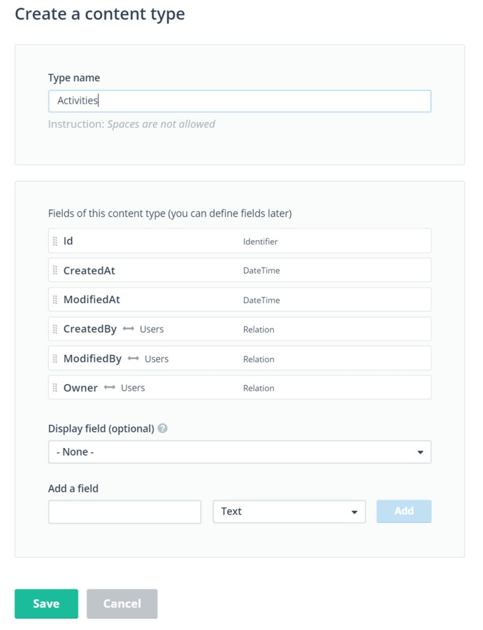
Creating Content
There are some default Fields .. you set up the rest

Slide 18
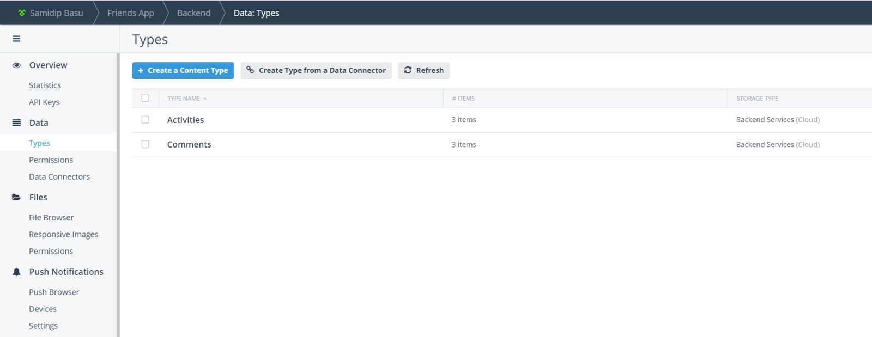
Manage your Content
All Content Types & Data - accessible through portal

Slide 19
#3. Your Data, Our APIs
Best part about Backend Content = Easy APIs
REST API created auto-magically on top of Content No need to write your own Services/APIs
REST API for any app, any platform

Slide 20
Let's manage Data
Yes, you can do plain RESTful service calls
But SDKs make the integrations so much easier
Seamless CRUD operations!

Slide 21
I see EverLive
Internal name for Backend Services Used in namespaces & SDKs
Entry point into Backend Services SDK is through ..
The Everlive class
You normally create one global instance of 'Everlive' Needs your Backend API Key

Slide 22
Here's how you start
.NET SDK
EverliveApp myApp = new EverliveApp("your-api-key-here");
JavaScript SDK
var el = new Everlive('your-api-key-here');

Slide 23
Read data from Backend
.NET code, granted you have a content called 'Activity'
Single item by Id
public async Task GetSingleItem(EverliveApp app, Guid activityId)
{
var activity = await app.WorkWith().Data<Activity>().GetById(activityId)
.ExecuteAsync(); Debug.WriteLine("Activity: " + activity.Text);
}
Multiple items
public async Task GetMultipleItems(EverliveApp app)
{
var activities = await app.WorkWith().Data<Activity>().GetAll().ExecuteAsync(); foreach(var activity in activities)
{
Debug.WriteLine("Activity: " + activity.Text);
}
}

Slide 24
Manipulate data from Backend
.NET code, granted you have a content called 'Activity'
Update
public async Task UpdateActivityById(EverliveApp app, Guid activityId,
Activity updatedActivity)
{
await app.WorkWith().Data<Activity>().Update(activityId, updatedActivity)
.ExecuteAsync();
}
Delete
public async Task DeleteById(EverliveApp app, Guid id)
{
await app.WorkWith().Data<Activity>().Delete(id).ExecuteAsync();
}

Slide 25
#4. Let's talk Data Connectors
We know you have existing data Variety of DB providers = disparate content
Painful Service layers to expose data
It's time to bridge your On-premise data
You'll love this

Slide 26
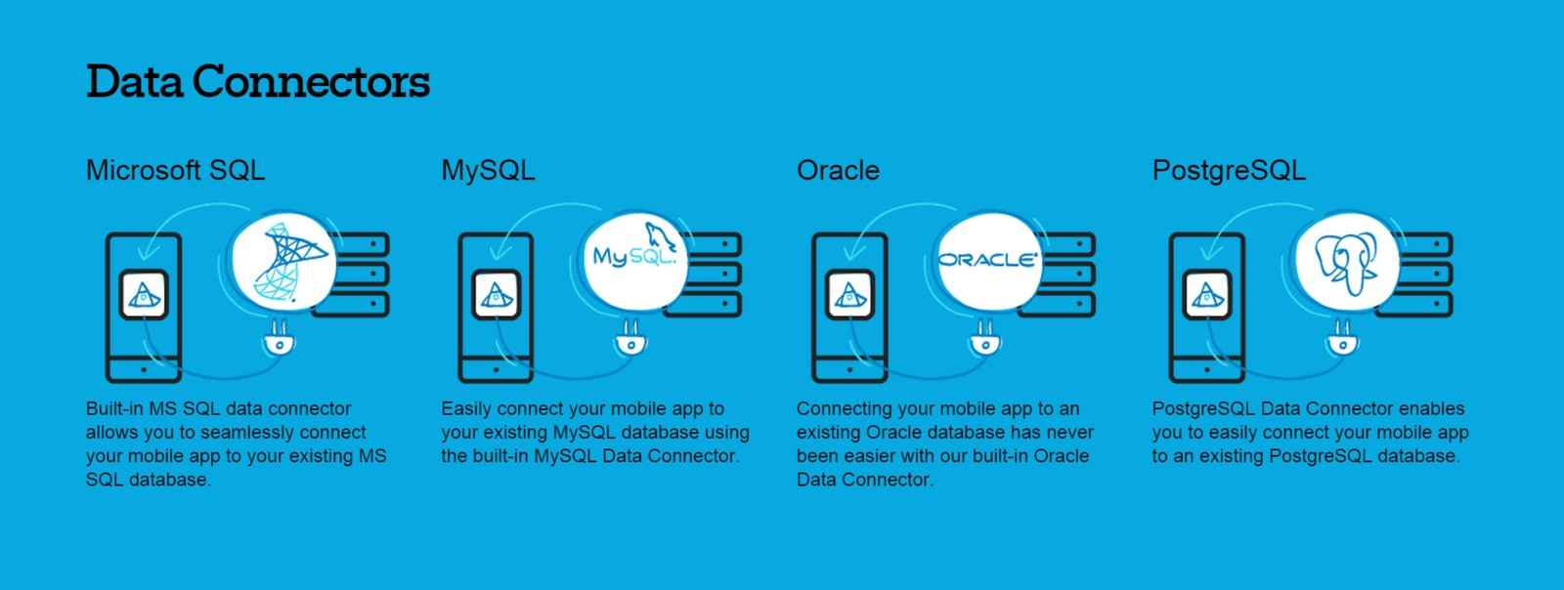
Data Connector flexibility
Set your on-premises data free ..

Slide 27
How does it work?
You download & install an IIS app ..
It's the Data Link Server
Simply point to your on-premise Data storage
You create Mapped Content
Your data stays in house .. uses Backend API
Free REST API over your data!

Slide 28
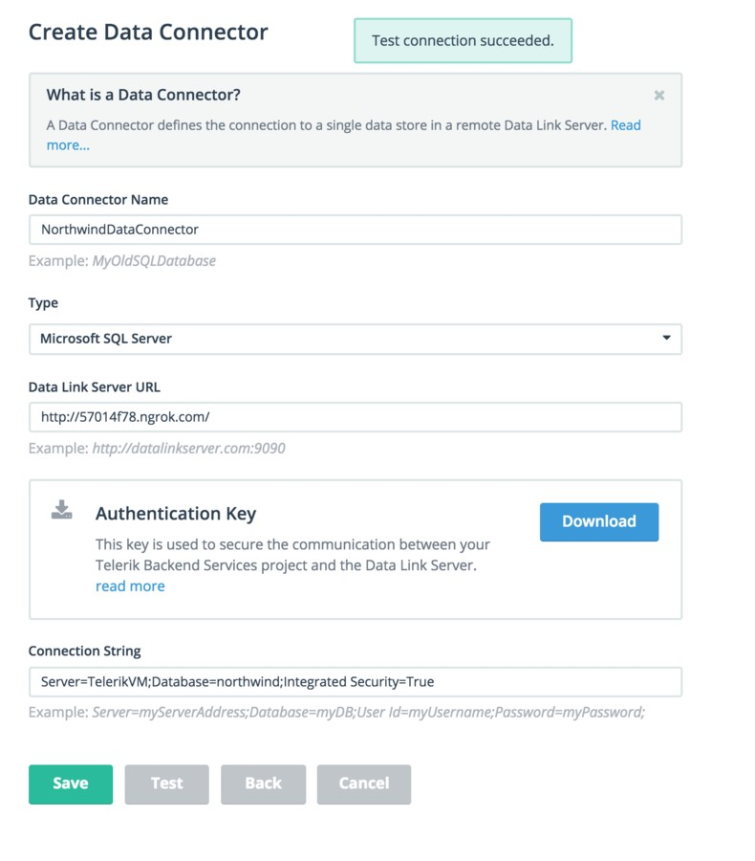
Don't code, just Configure!
Simply make your Data Link Server accessible And use Connection String to point to your data ..

Slide 29

#5. Got Non-Relational data?
Yep, Backend Services allows you deal with Files Think of it as Blob storage in the Cloud
And it's super scalable
Same RESTful API for your Files

Slide 30
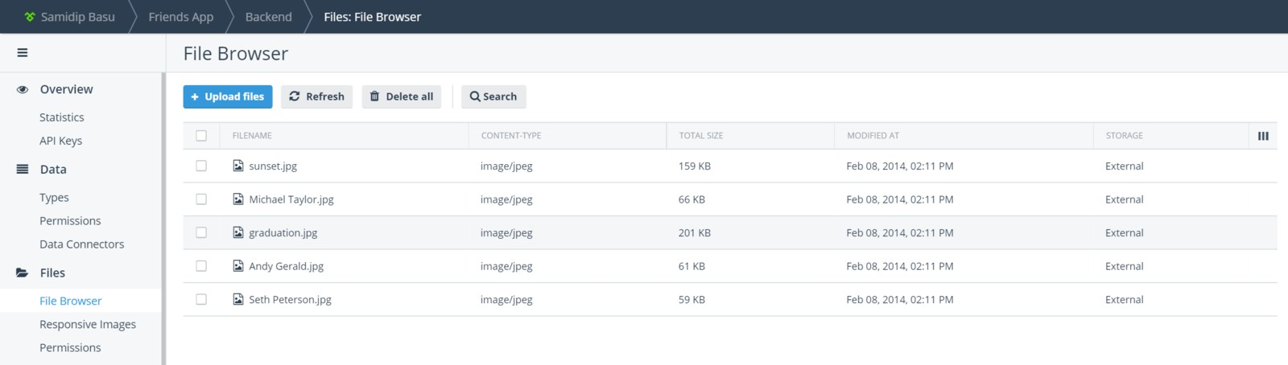
Backend portal helps manage Files
Users can take pictures & upload to Backend 2 lines of code for developers from any SDK
File delivery powered by global CDNs .. it's free!

Slide 31
#6. Let's talk User Management
Traditionally, bothersome for developers ..
User authentication/authorization = Tricky Account management = Security concerns
Backend Services to the rescue

Slide 32
User Management - Elevated
New user registration
Automatic email flow for newly-registered accounts
Fine-grained control over User accounts
User Password management flows
User authentication through OAuth providers (Facebook, Google+, Live Connect, Twitter)
User authentication through Active Directory Federation Services (AD FS) authentication provider
Account deletion

Slide 33
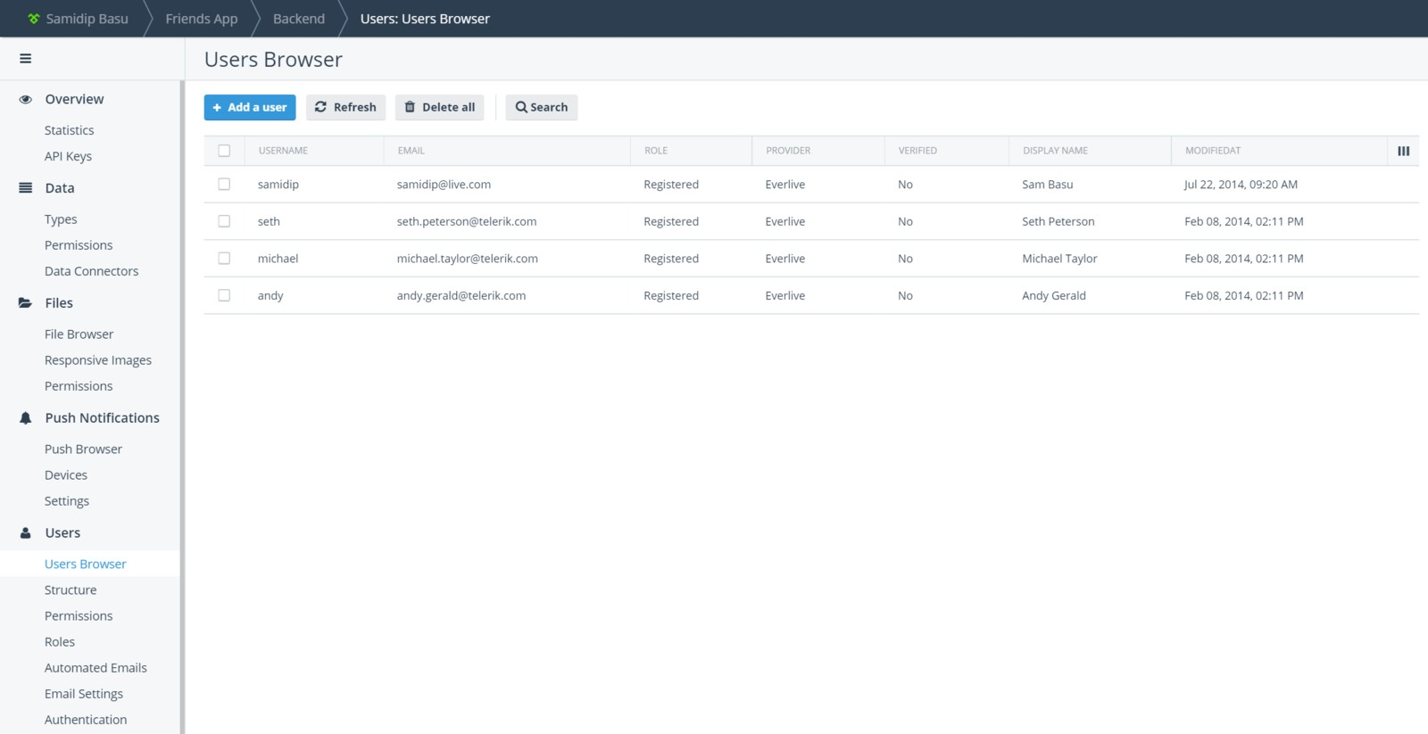
User Management in the Cloud
Automated Email Templates .. everything on portal

Slide 34
#7. Let's talk Push Notifications
Push Notifications are a great way to engage users Present on every Mobile platform
Captures user attention even when app not running
It should be a no-brainer, right?

Slide 35
Push Notifications are actually hard!
Configuring Push Notifications is tough for developers Every Mobile platform does it differently
Apple, Google, Microsoft - all have own rules & setup
Backend Services is here to help

Slide 36
Push Notifications in Backend Services
Works X-Platform for iOS, Android & Windows
Powerful targeting to filter on devices
Smart grouping on users/geography
Works for native or hybrid mobile apps

Slide 37
How to work Push Notifications
Register device for Push from mobile app
Enable Push Notifications per platform
Build Segments for Filtering - user/device
Send Push Notifications from Backend
Push can also be triggered from REST endpoint

Slide 38
Device Registration for Push
All this achieved with 2 lines of code
.NET
await app.WorkWith().Push().CurrentDevice.Initialize(PushSettings)
.ExecuteAsync();
var result = await app.WorkWith().Push().CurrentDevice.
Register(DeviceParameters customParameters)
.ExecuteAsync();
JavaScript
var el = new Everlive('your-api-key-here'); el.push.register(
pushSettings,
function successCallback(data) {}, function errorCallback(error) {}
);

Slide 39
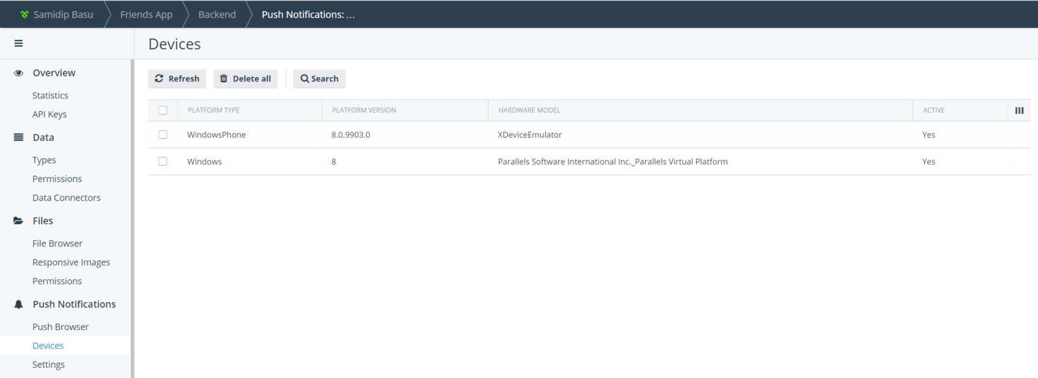
Device list on portal
Manage registered devices .. even works on simulators

Slide 40
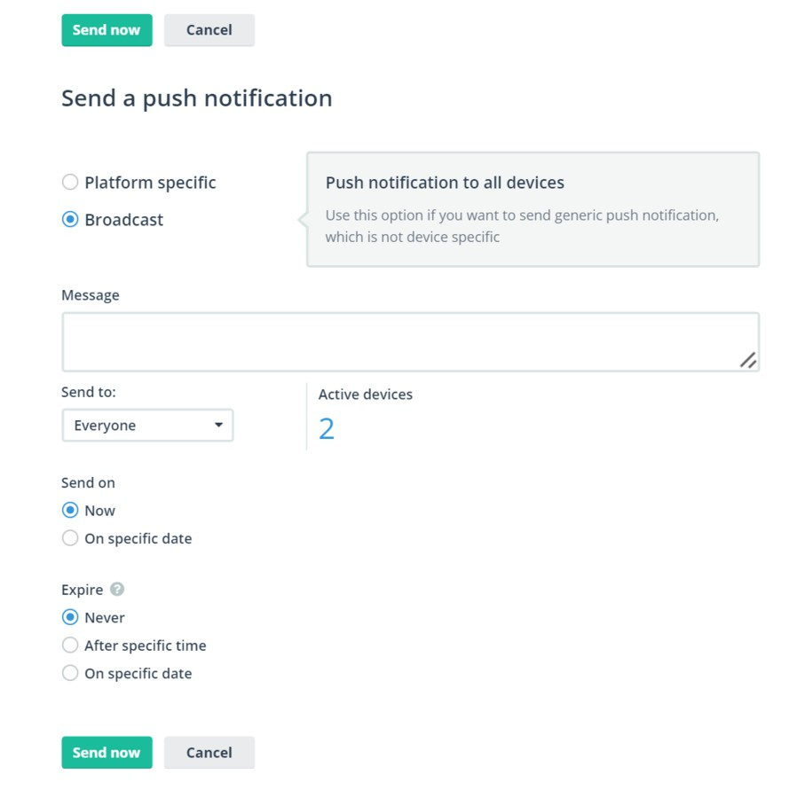
Sending Push Notifications from portal
Broadcast to all devices or be Platform specific
Payload can be tweaked for iOS/Android/Windows

Slide 41
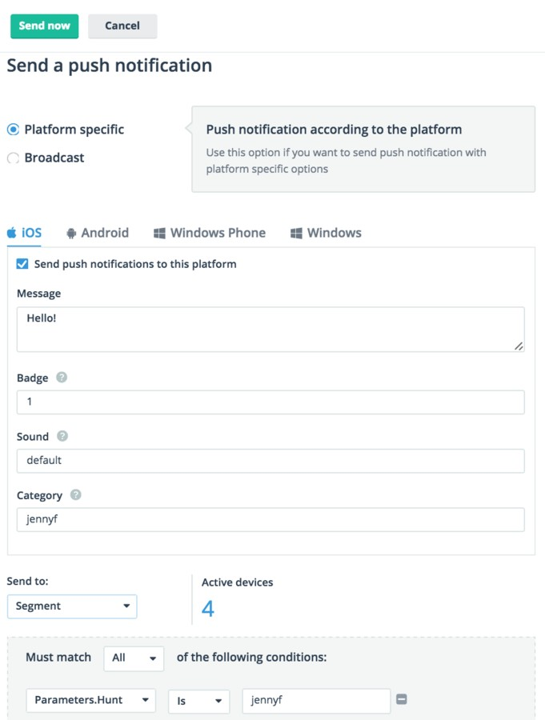
Sending Push Notifications from portal
Here's an iOS specific Push Notification Parameters in Segments allows you to filter devices

Slide 42
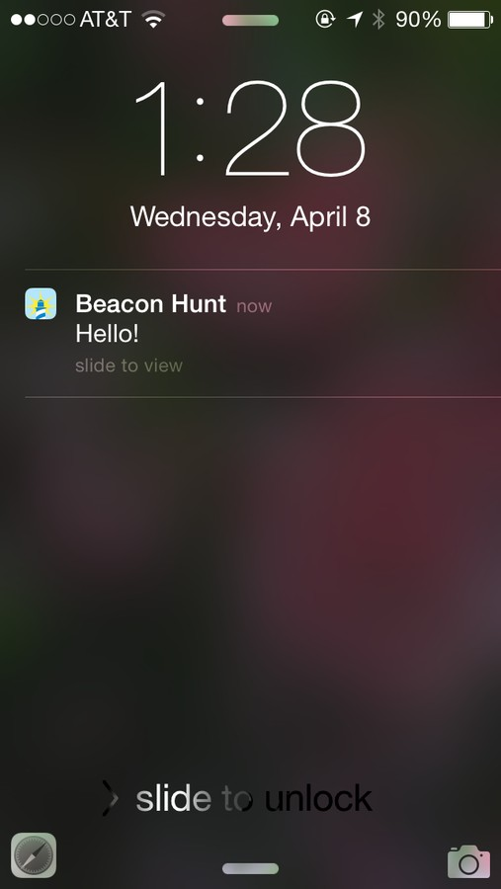
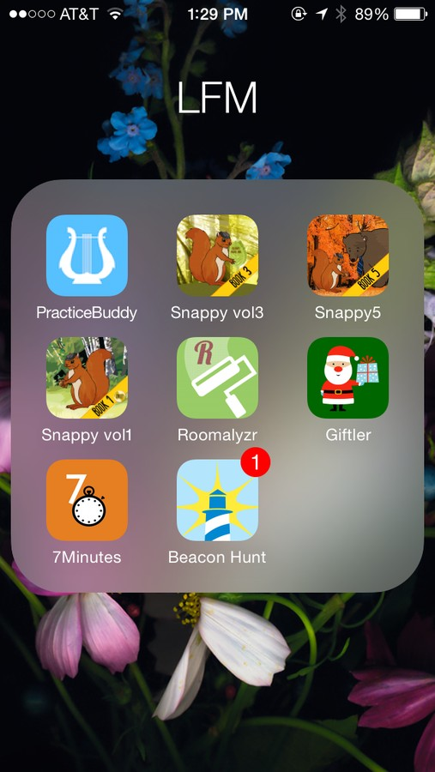
Push Notifications in action!
Works on Devices or Simulators
Can be triggered through a REST endpoint

Slide 43

#8. Let's talk Cloud Code
For times when you need custom logic server-side Simplicity of JavaScript
Yes, this is based on Node.js
Built-in inside Backend Services

Slide 44
Types of Cloud Code
Content Type Code - like DB triggers | works on content | acts before/after CRUD operations​
Cloud Functions - custom JavaScript code | each function gets REST endpoint | invoke anytime
You can write Cloud Code ..
Directly in Backend or Upload custom JS file

Slide 45

#9. Let's talk Responsive Images
Images are selling points of many apps
Yet, ill-sized images are the biggest bandwidth hogs Makes whole app feel sluggish
Backend Services does the heavy work

Slide 46
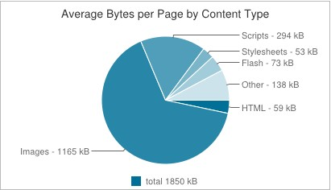
Here's why Images are important
Typical HTTP bandwidth usage Critical to optimize in Mobile first world

Slide 47
Responsive Images in Backend
Automatic image re-sizing on server
Caters to exact device form factor
Bandwidth & app optimization
Support for high DPI retina devices
Platform agnostic
Image delivery over global CDNs
Simple JavaScript to set up

Slide 48
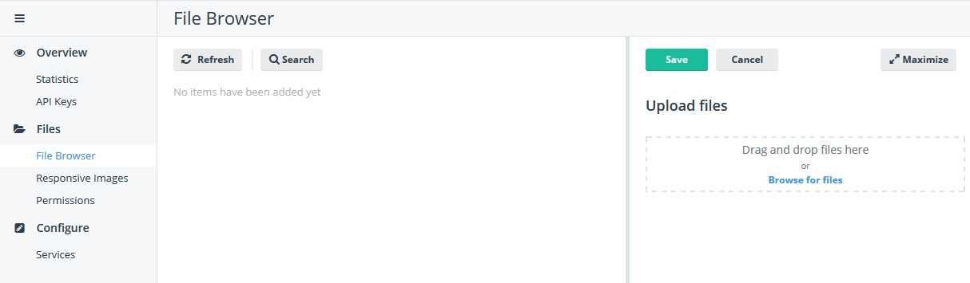
Simply upload an Image to Backend
Works even if you are self-hosting images ..
https://bs1.cdn.telerik.com/image/v1/your-api-key-here/ resize=rezise-options-here/URI-to-image-here
URI to Responsive Image .. like magic!

Slide 49
That's a lot of features ...
Everything you need from a Modern, Robust, Scalable Backend
Feeling empowered?
Let's Recap

Slide 50
Telerik Backend Services
Relational or Non-relational data in the cloud
Automatic REST API on top of data
Data Connectors for On-premise data
Wrapper SDKs for any app on any platform
Robust User Management
Easy X-Platform Push Notifications
Cloud Code for server-side logic & much more
Complete BaaS offering

Slide 51
Telerik Backend Services
Get started today http://www.telerik.com/backend-services
Go build your client app .. you Backend awaits!

